Slide 1

MALIGNANT COMMENT CLASSIFICATION
Mahaboob Basha Shaik

Slide 2
INTRODUCTION
Internet comments are bastions of hatred and vitriol. While online anonymity has provided a new outlet for aggression and hate speech, machine learning can be used to fight it.
The problem we sought to solve was the tagging of internet comments that are aggressive towards other users.
This means that insults to third parties such as celebrities will be tagged as unoffensive, but “u are an idiot” is clearly offensive.
Our goal is to build a prototype of online hate and abuse comment classifier which can used to classify hate and offensive comments so that it can be controlled and restricted from spreading hatred and cyberbullying.

Slide 3
Problem statement
The proliferation of social media enables people to express their opinions widely online. However, at the same time, this has resulted in the emergence of conflict and hate, making online environments uninviting for users.
Although researchers have found that hate is a problem across multiple platforms, there is a lack of models for online hate detection.
Online hate, described as abusive language, aggression, cyberbullying, hatefulness and many others has been identified as a major threat on online social media platforms.
Social media platforms are the most prominent grounds for such toxic behaviour.

Slide 4
Data Sources
The data set includes:
Malignant: It is the Label column, which includes values 0 and 1, denoting if the comment is malignant or not.
Highly Malignant: It denotes comments that are highly malignant and hurtful.
Rude: It denotes comments that are very rude and offensive.
Threat: It contains indication of the comments that are giving any threat to someone.
Abuse: It is for comments that are abusive in nature.
Loathe: It describes the comments which are hateful and loathing in nature.
ID: It includes unique Ids associated with each comment text given.
Comment text: This column contains the comments extracted from various social media platforms.
The label can be either 0 or 1, where 0 denotes a NO while 1 denotes a YES. There are various comments which have multiple labels. The first attribute is a unique ID associated with each comment.

Slide 5
Data Pre processing
The dataset consists of the following fields-
id: An 8-digit integer value, to get the identity of the person who had written this comment
comment_text: A multi-line text field which contains the unfiltered comment
toxic: binary label which contains 0/1 (0 for no and 1 for yes)
severe_toxic: binary label which contains 0/1
obscene: binary label which contains 0/1
threat: binary label which contains 0/1
insult: binary label which contains 0/1
identity_hate: binary label which contains 0/1
Out of these fields, the comment_text field will be pre processed and fitted into different classifiers to predict whether it belongs to one or more of the labels/outcome variables (i.e. toxic, severe_toxic, obscene, threat, insult and identity_hate).

Slide 6
PROBLEM TRANSFORMATION METHODS
Binary Relevance Method: This method does not take into account the interdependence of labels. Each label is solved separately like a single label classification problem. This is the simplest approach to be applied.
Classifier Chain Method: In this method, the first classifier is trained on input data and then each of the next classifier is trained on the input space and previous classifier, and so on.
Label Powerset Method: In this method, we consider all unique combinations of labels possible. Any one particular combination hence serves as a label, converting our multi-label problem to a multi class classification problem. Considering our dataset, many comments are such that they have 0 for false labels all together and many are such that obscene and insult are true together.

Slide 7
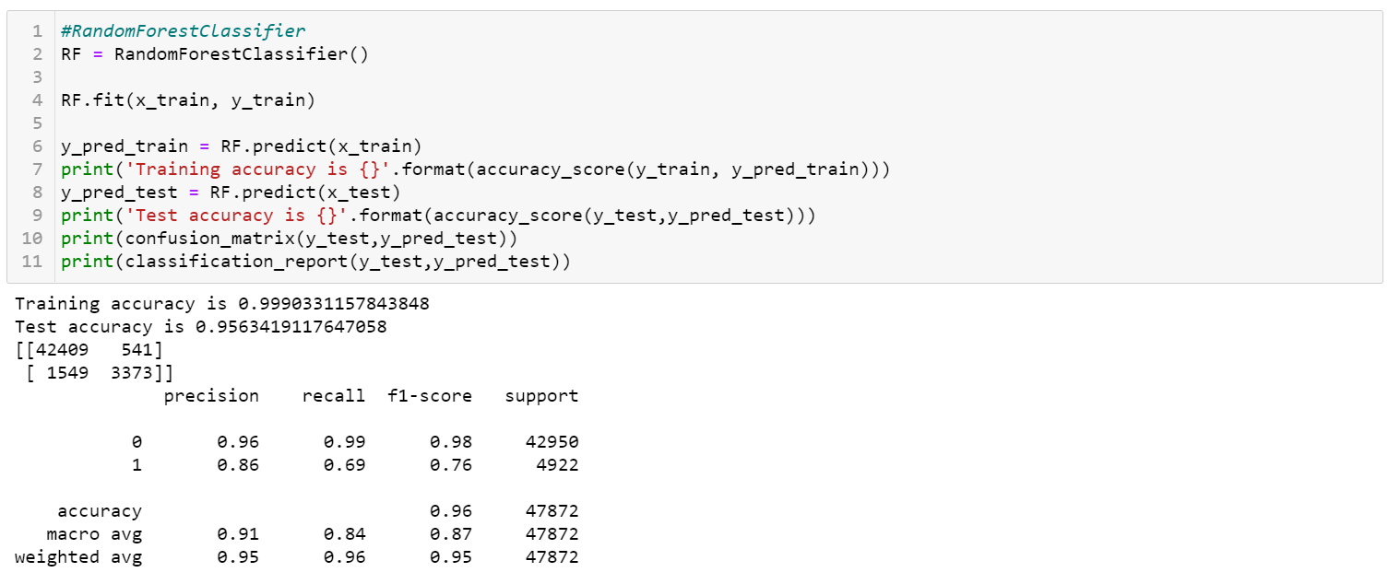
Evaluate selected models

Slide 8
CONCLUSION
The first step involved collecting data and deciding what part of it is suitable for training
The second major step was performing cleaning of data including punctuation removal, stop word removal, stemming and lemmatizing
The third step was choosing models to train on: Since I had a wide variety of models( 3 for problem transformation) and classifiers(not bounded) along with number of adaptation models in BP-MLL, selecting which all models to train and test took lots of efforts.

Slide 9
Scope for Future Work
The current project predicts the type or toxicity in the comment. We are planning to add the following features in the future:
Analyse which age group is being toxic towards a particular group or brand.
Add feature to automatically sensitize words which are classified as toxic.
Automatically send alerts to the concerned authority if threats are classified as severe.
Build a feedback loop to further increase the efficiency of the model.
Handle mistakes and short forms of words to get better accuracy of the result.

